Slide 1

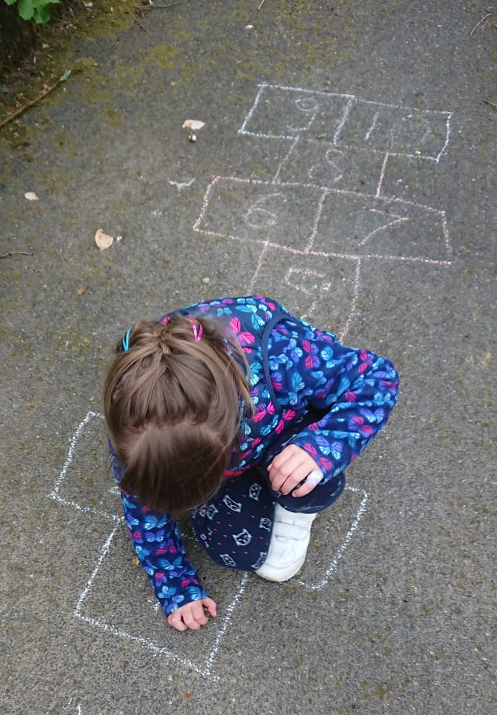
Supporting EAL Children’s Learning
A Guide for Parents
Objectives:
1. To understand:
• How to support EAL child’s learning by
using their first language
• Why it’s important to support a child’s
first language development
2. To share a few ideas of how to support a child’s learning using their first language and in English
3. To share links to useful resources to support with home learning and language development

Slide 2


Supporting a child’s learning using first language:
• Discuss new concepts in first language
• Research a topic taught in school in first language
• Play with children using first language
• Use bilingual dictionaries to check new English vocabulary
Create and use bilingual glossaries
Encourage your child to write in their first language
Read and listen to stories in first languages, talk and ask questions about these stories
• Visit home countries and ensure your children have frequent contact with family members
• Send your children to supplementary language schools

Slide 3
How to support your child’s learning in English:
If EAL parents can speak English, they can support a child’s learning in English by:
• Reading stories
• Counting objects
• Singing English songs
• Supporting in RWInc
• Teach new English vocabulary currently taught in school

Slide 4
Why is it important to support a child’s first language development?
There are numerous advantages to being bilingual:
• Knowing two or more languages is a very useful life skill
• Developing listening, speaking, reading and writing skills in the child’s first language will aid their acquisition of the English language in these four strands
• For learners new to English, the first language provides a means to develop new concepts (e.g. time, place value in Math, properties of the materials in science)
• The first language plays an important role in the child’s identity and their sense of belonging to the family and the community
• Secure development of English and first language has a positive affect on an EAL child’s educational attainment

Slide 5
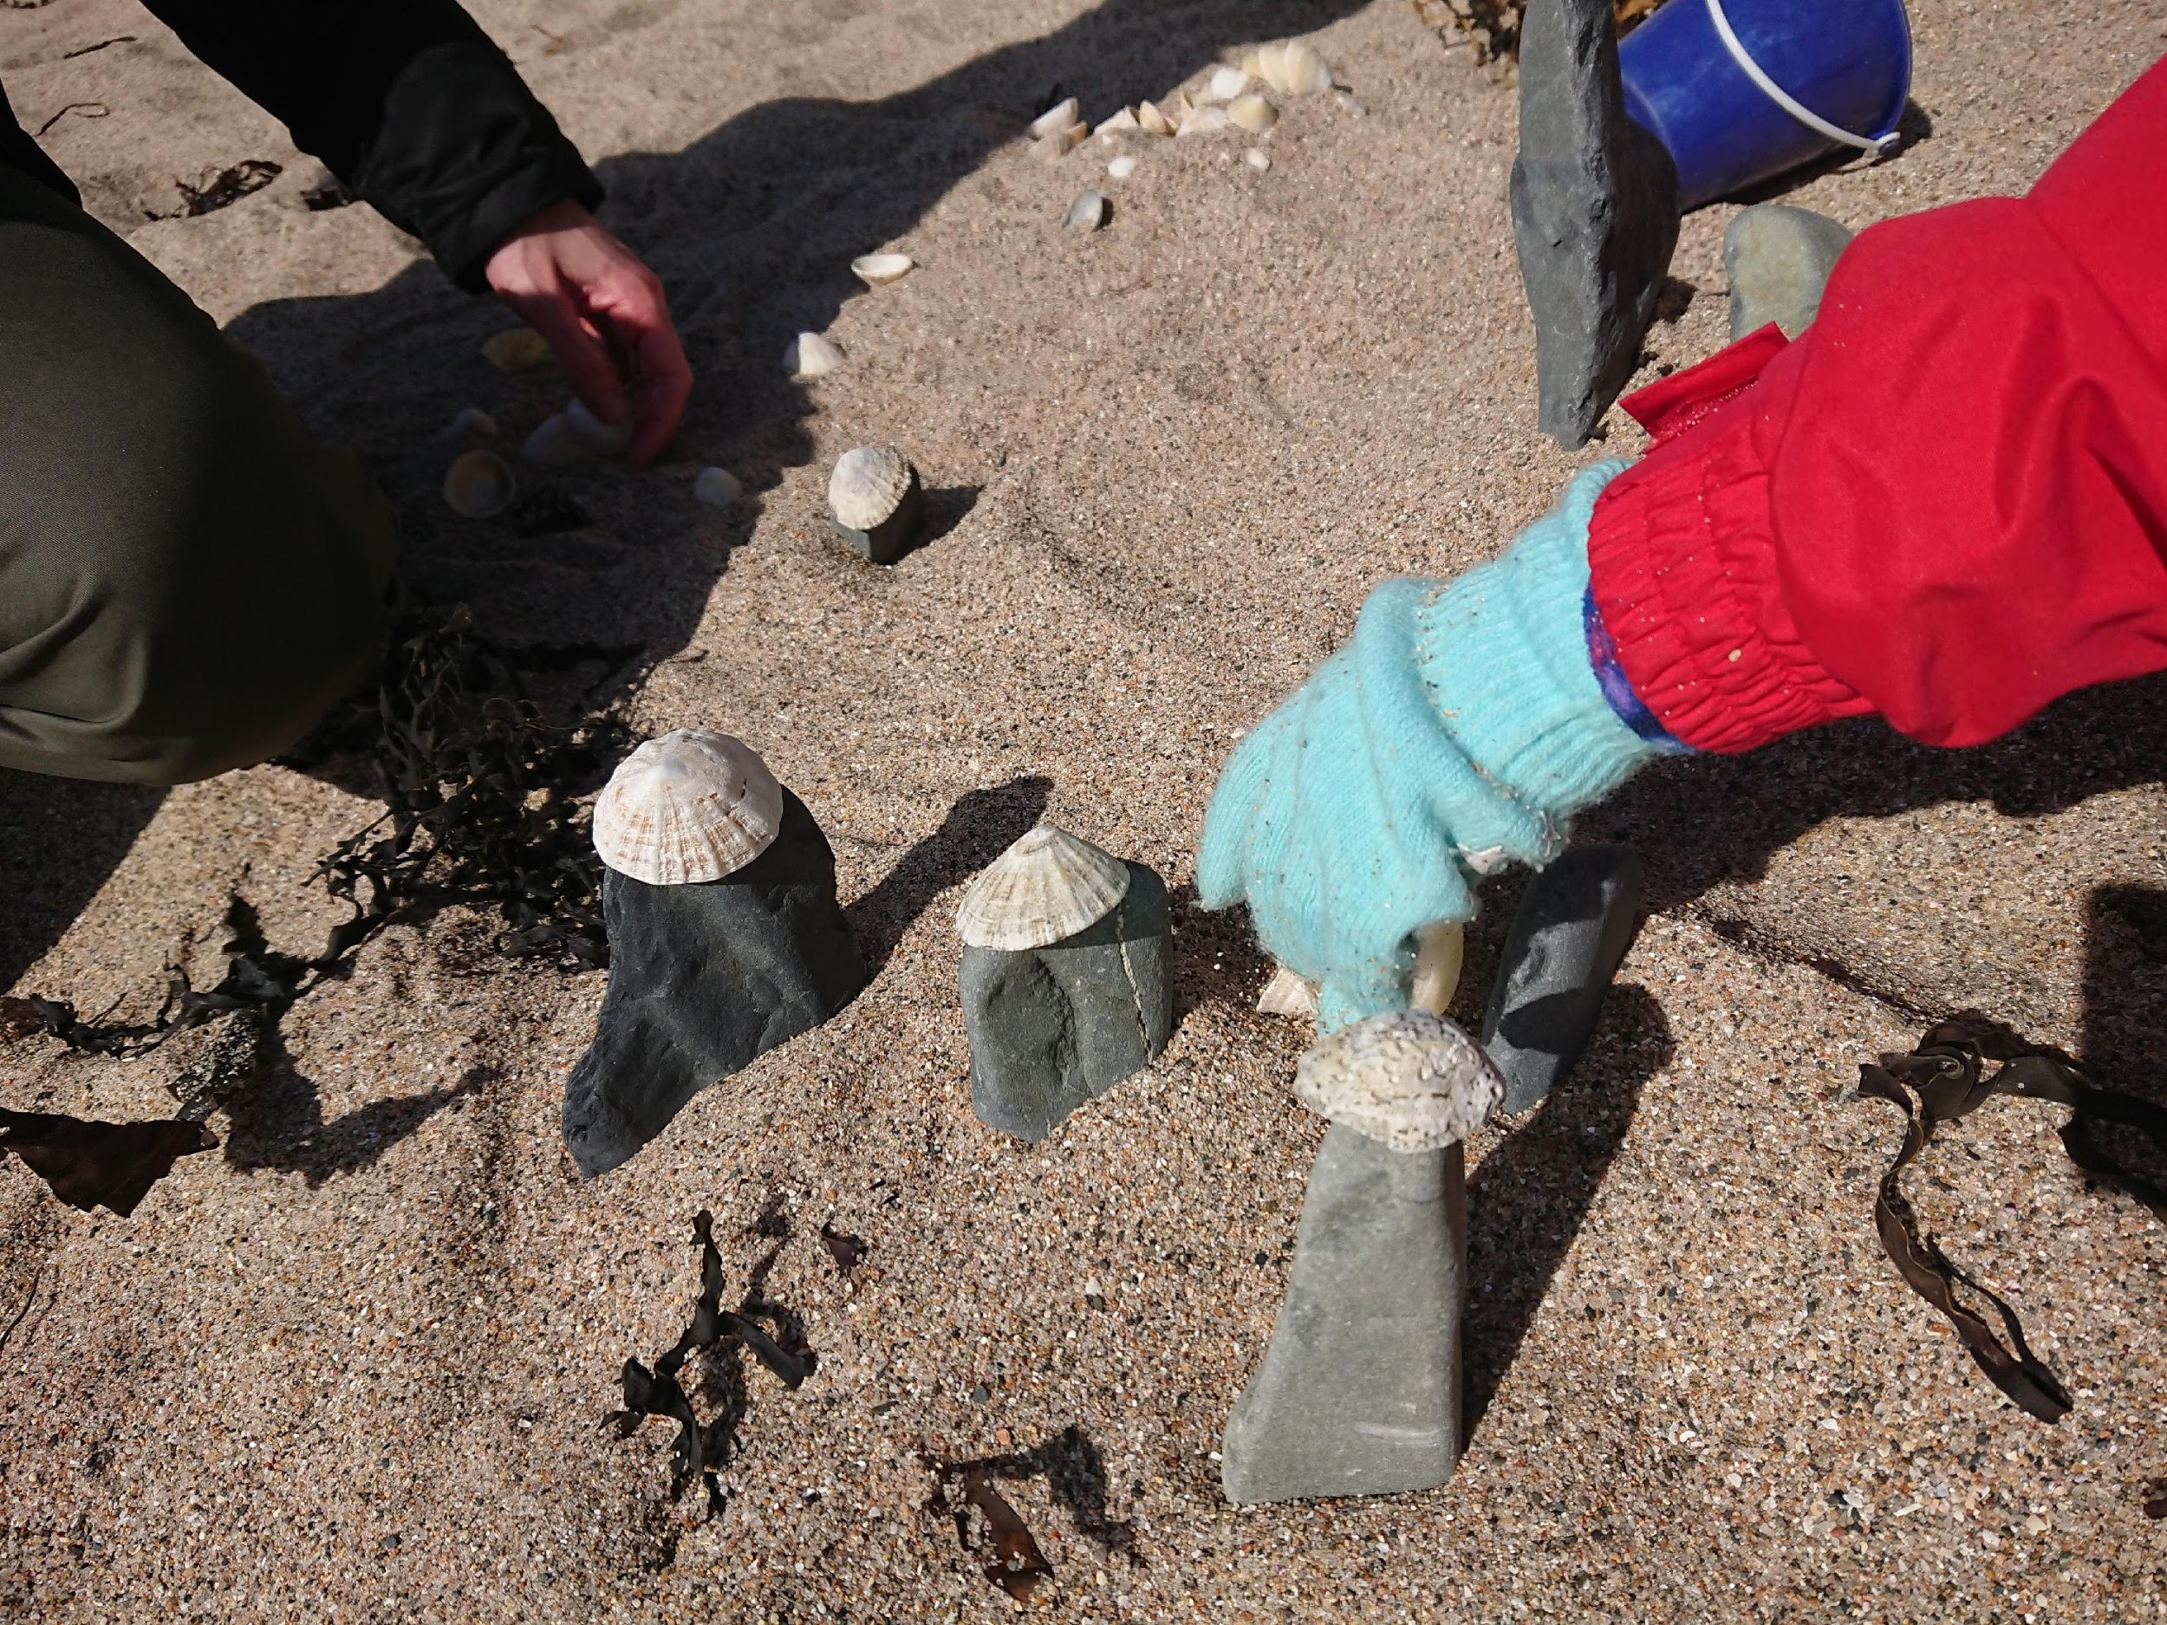
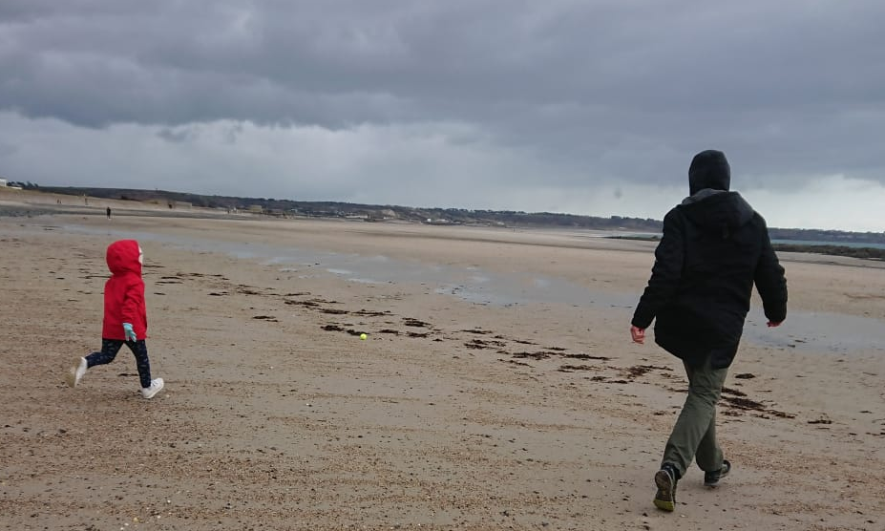
Supporting outdoor learning:
Speaking and Listening:
• Describe and compare different things you find in nature
Tell stories and create puppet shows with different things you’ve found whilst outdoors
Think about the senses; describe what you can see, feel, hear and smell
Be still, close your eyes and listen – can you describe what you can hear?

Slide 6

Supporting outdoor learning:
Literacy:
• Write poems whilst out in nature using idioms, similes, metaphors, alliterations, etc.
Write descriptive sentences of what you can see, remember to use a variety of adjectives
• Be curious and ask questions, where could you look to find the answers?
Write a ‘What am I?’ riddle about something
you’ve seen in nature?
I am as small as an ant,
Yet, some say I’m a lady,
On my red back there are black spots,
You may find me in your garden,
What am I?
• Describe and compare different objects
Read poems and stories outdoors

Slide 7
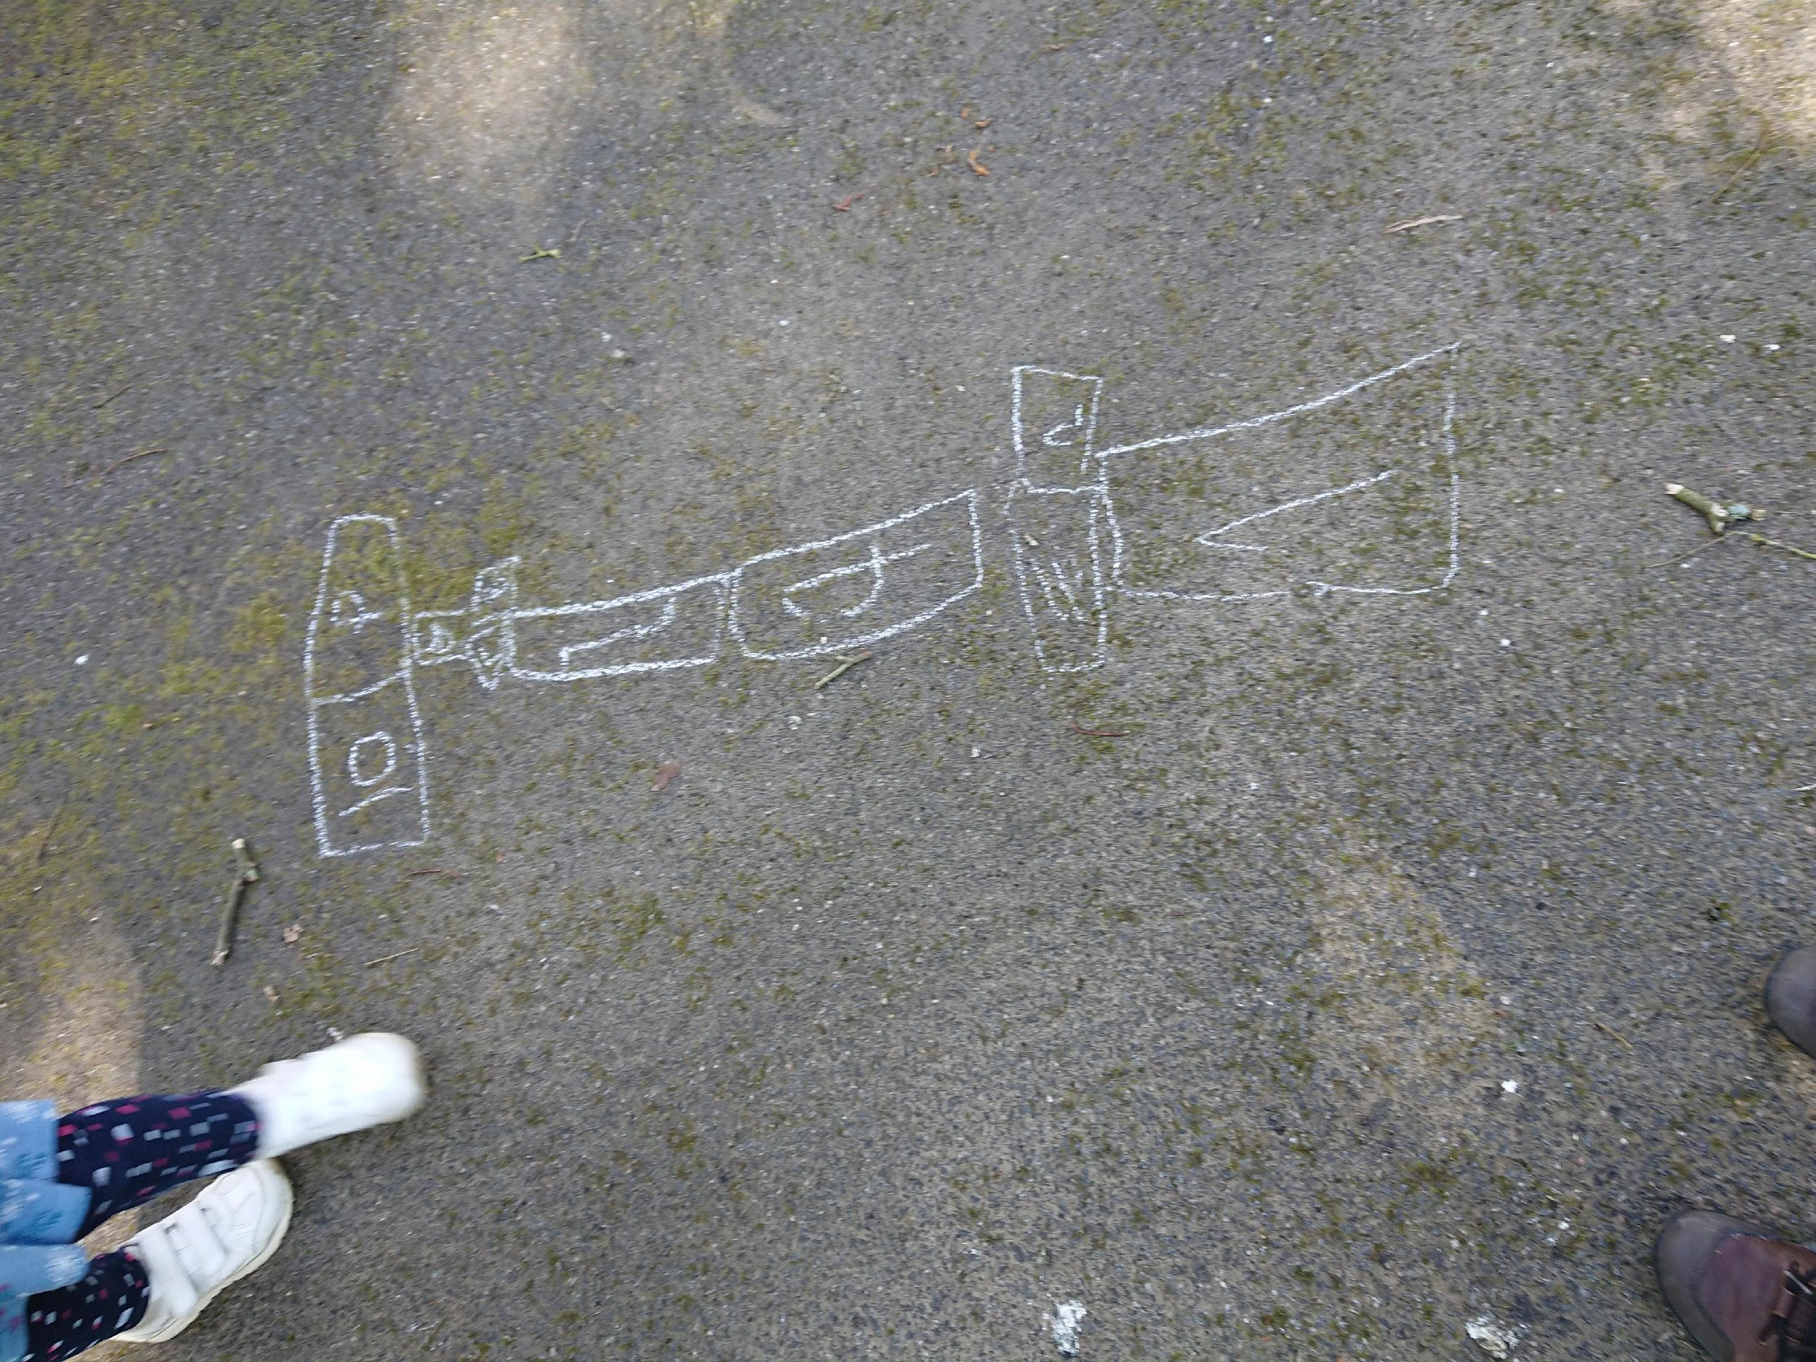
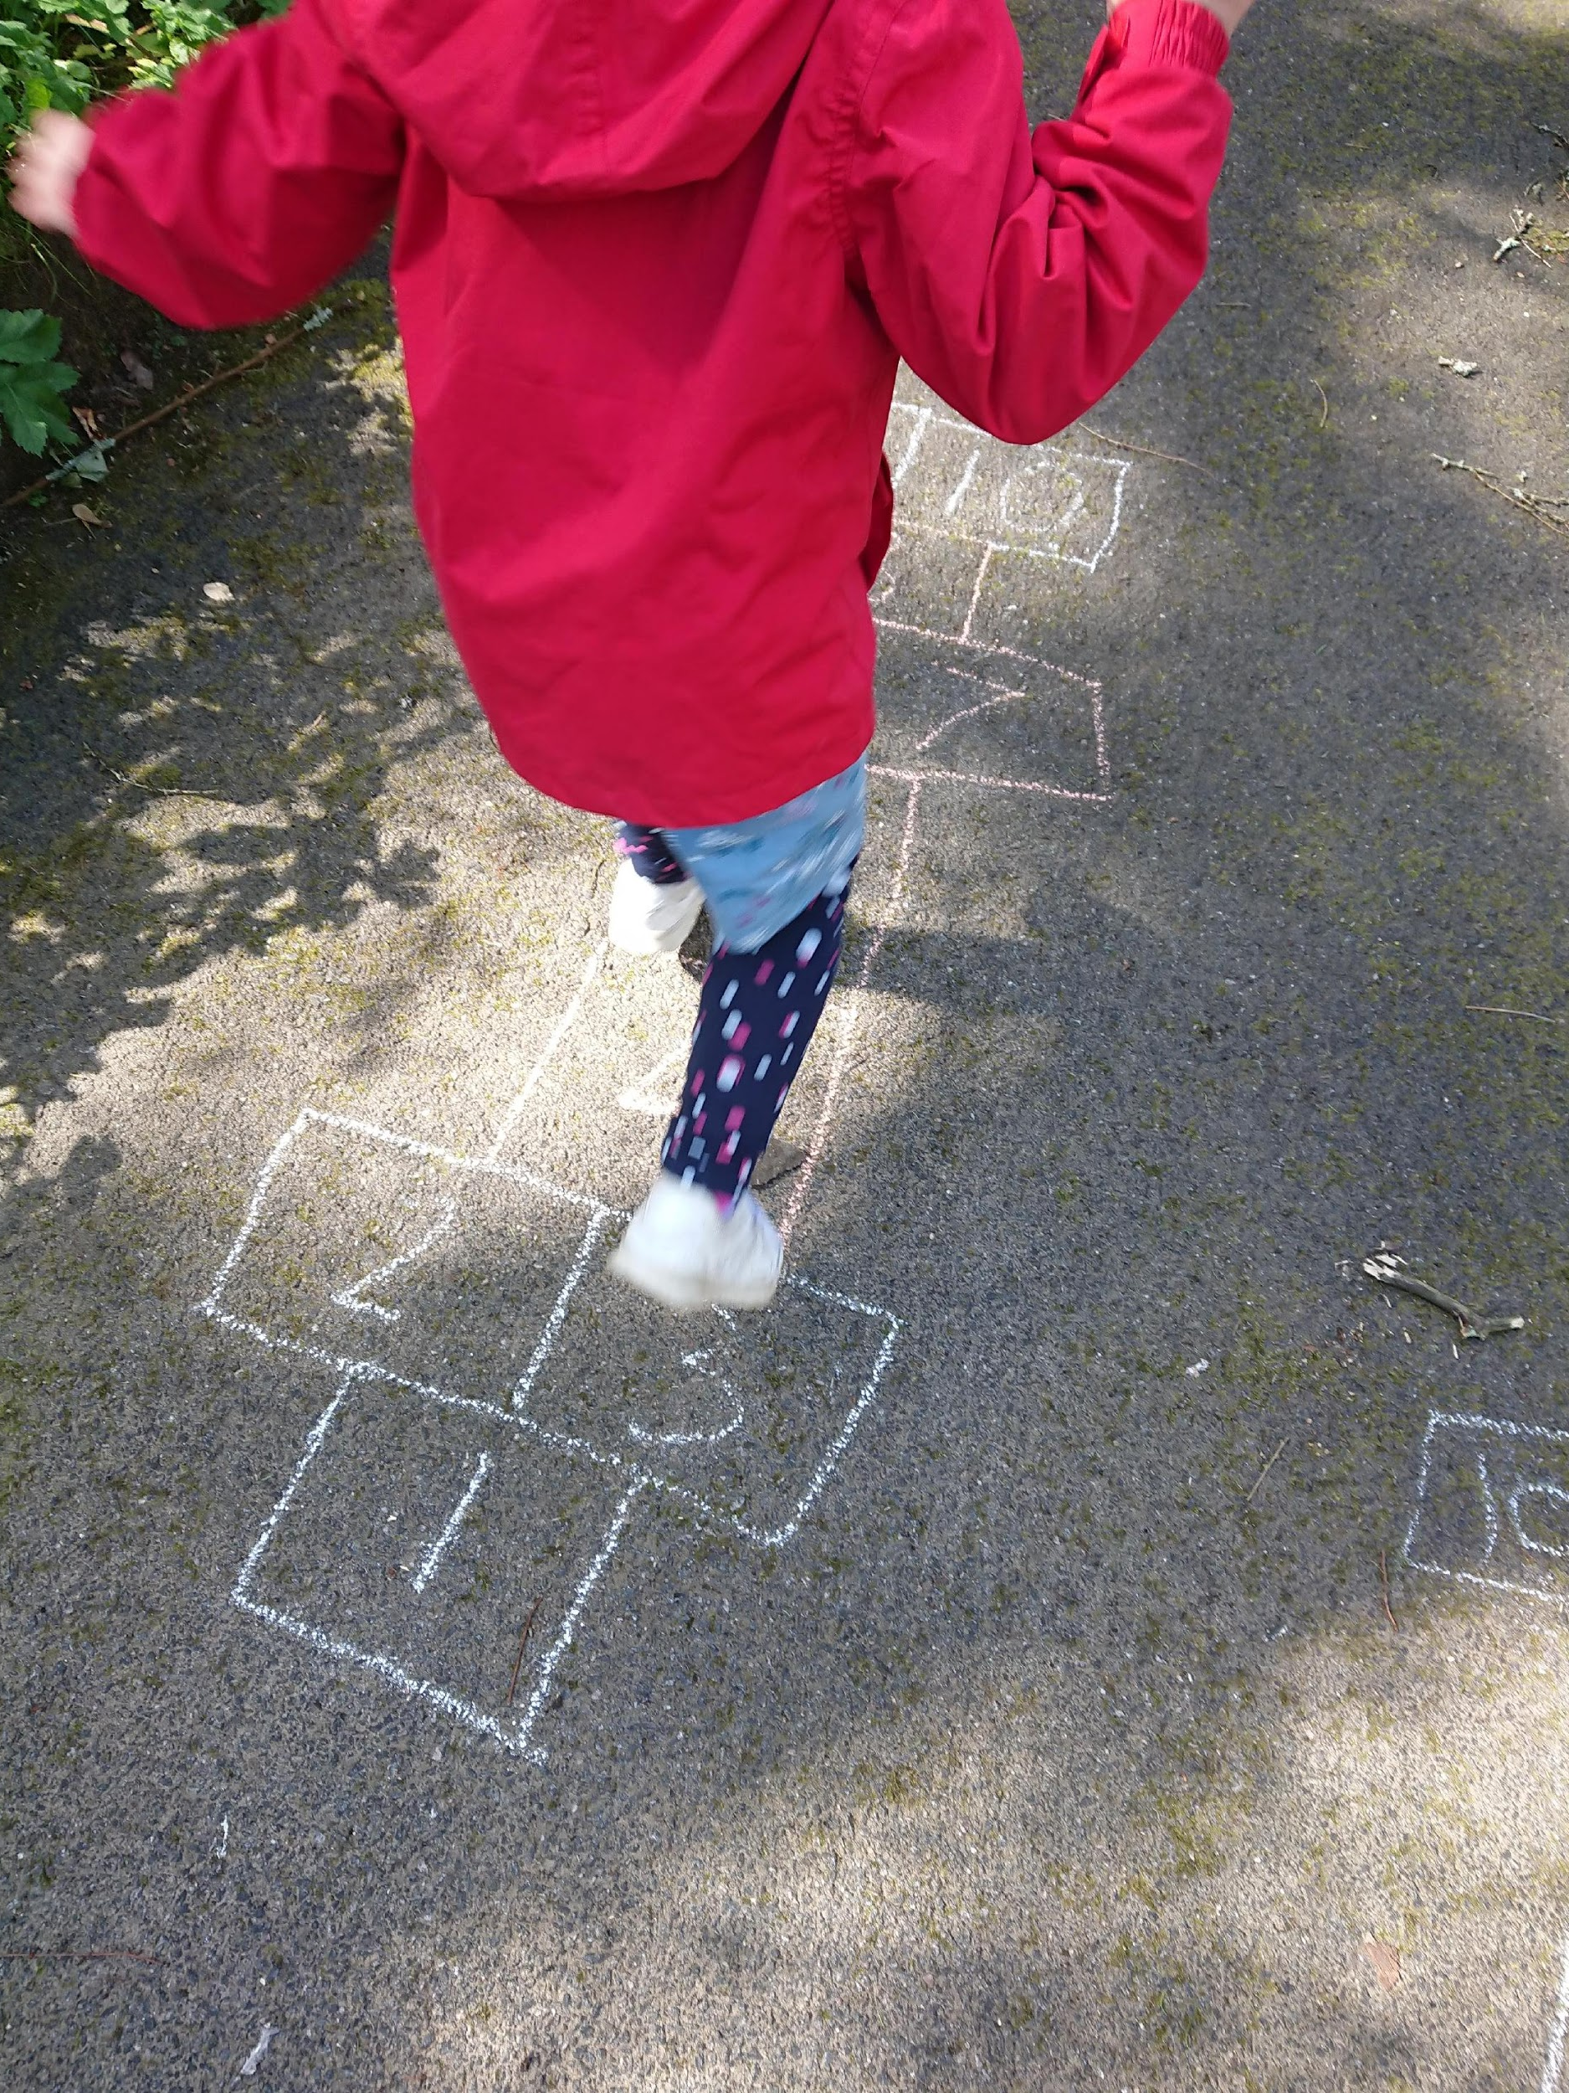
Supporting outdoor learning:
Maths:
Collect different objects on a nature walk; how can these be sorted into different groups?
How many different ways can you measure when outdoors?
Estimating; how many daisies are in a 1 meter square? Use this to estimate how many are on the whole lawn
Create tally charts of the different kinds of nature you can see outside?
Do a shape spot! What shapes can you spot in nature? What shapes can you make using nature?
Symmetry; can you make symmetrical pictures using objects found in nature?

Slide 8
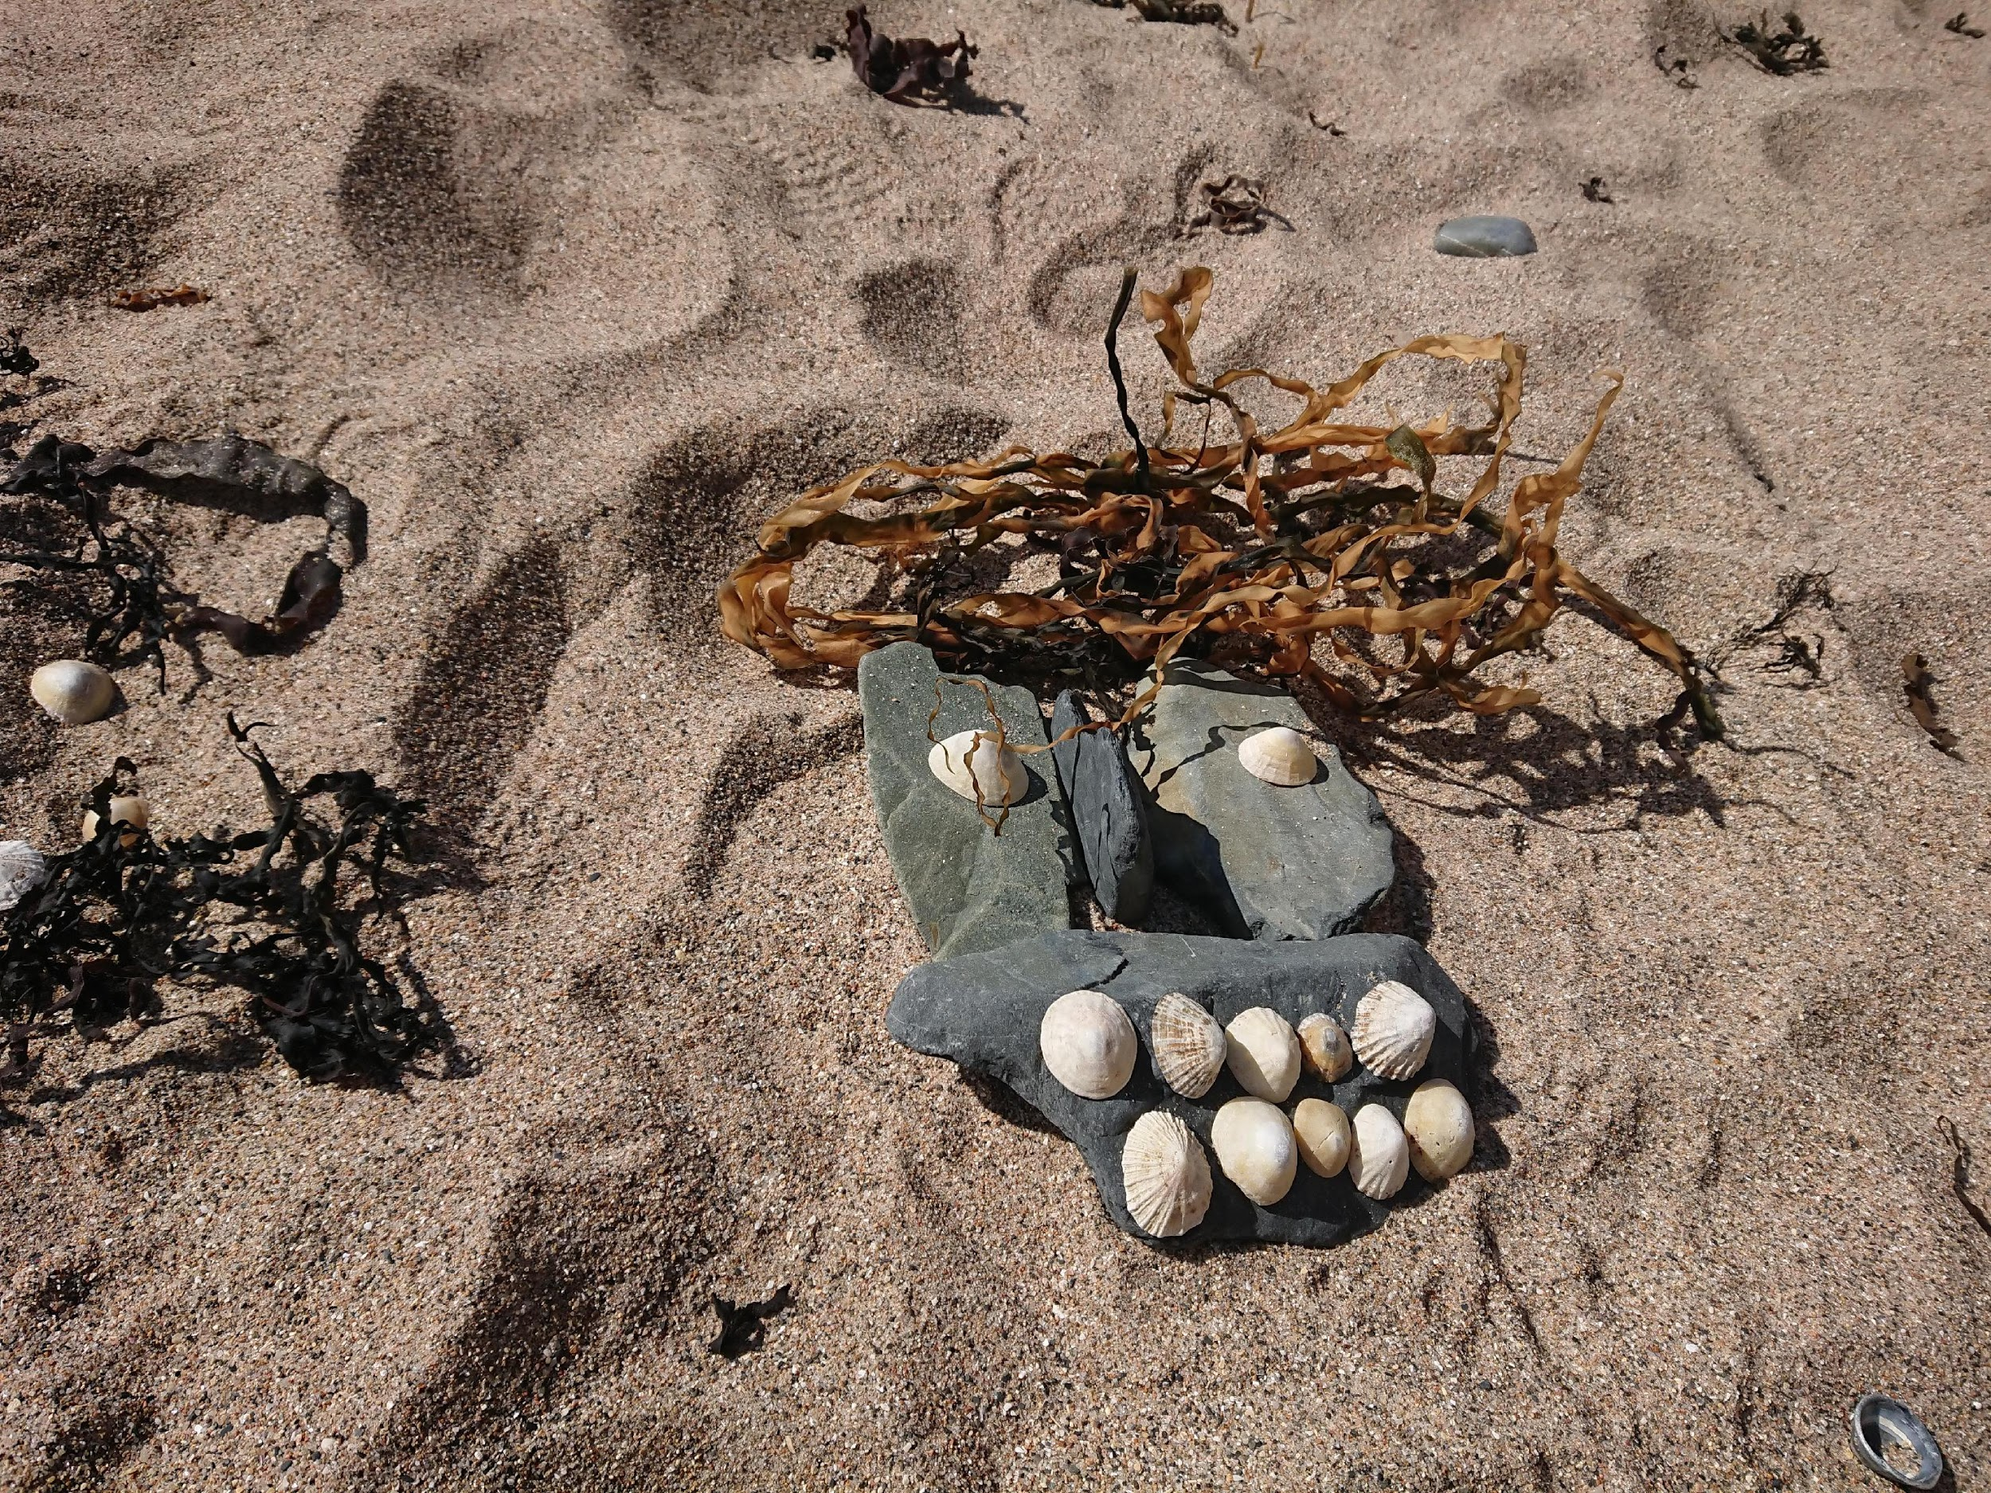
Supporting outdoor learning:
Imaginative play
and creativity:
Make sculptures using items
found outdoors
Make a bug hotel
Create and complete
a nature scavenger hunt

Slide 9
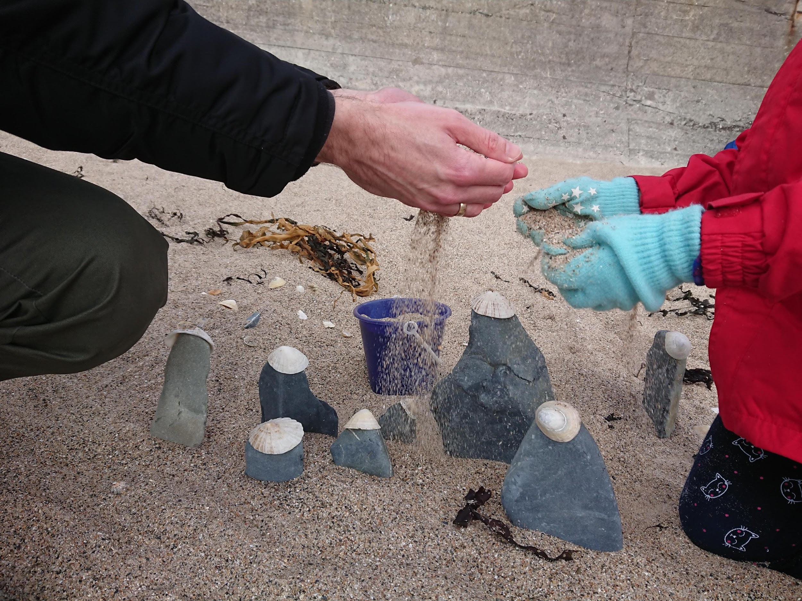
Supporting outdoor learning:
Science:
Talk about the different properties of materials
Simulate natural disasters
Make a rain gauge using an empty
water bottle, how can you record
your results?
How can you sort sand? Try using water, bowls and sieves

Slide 10
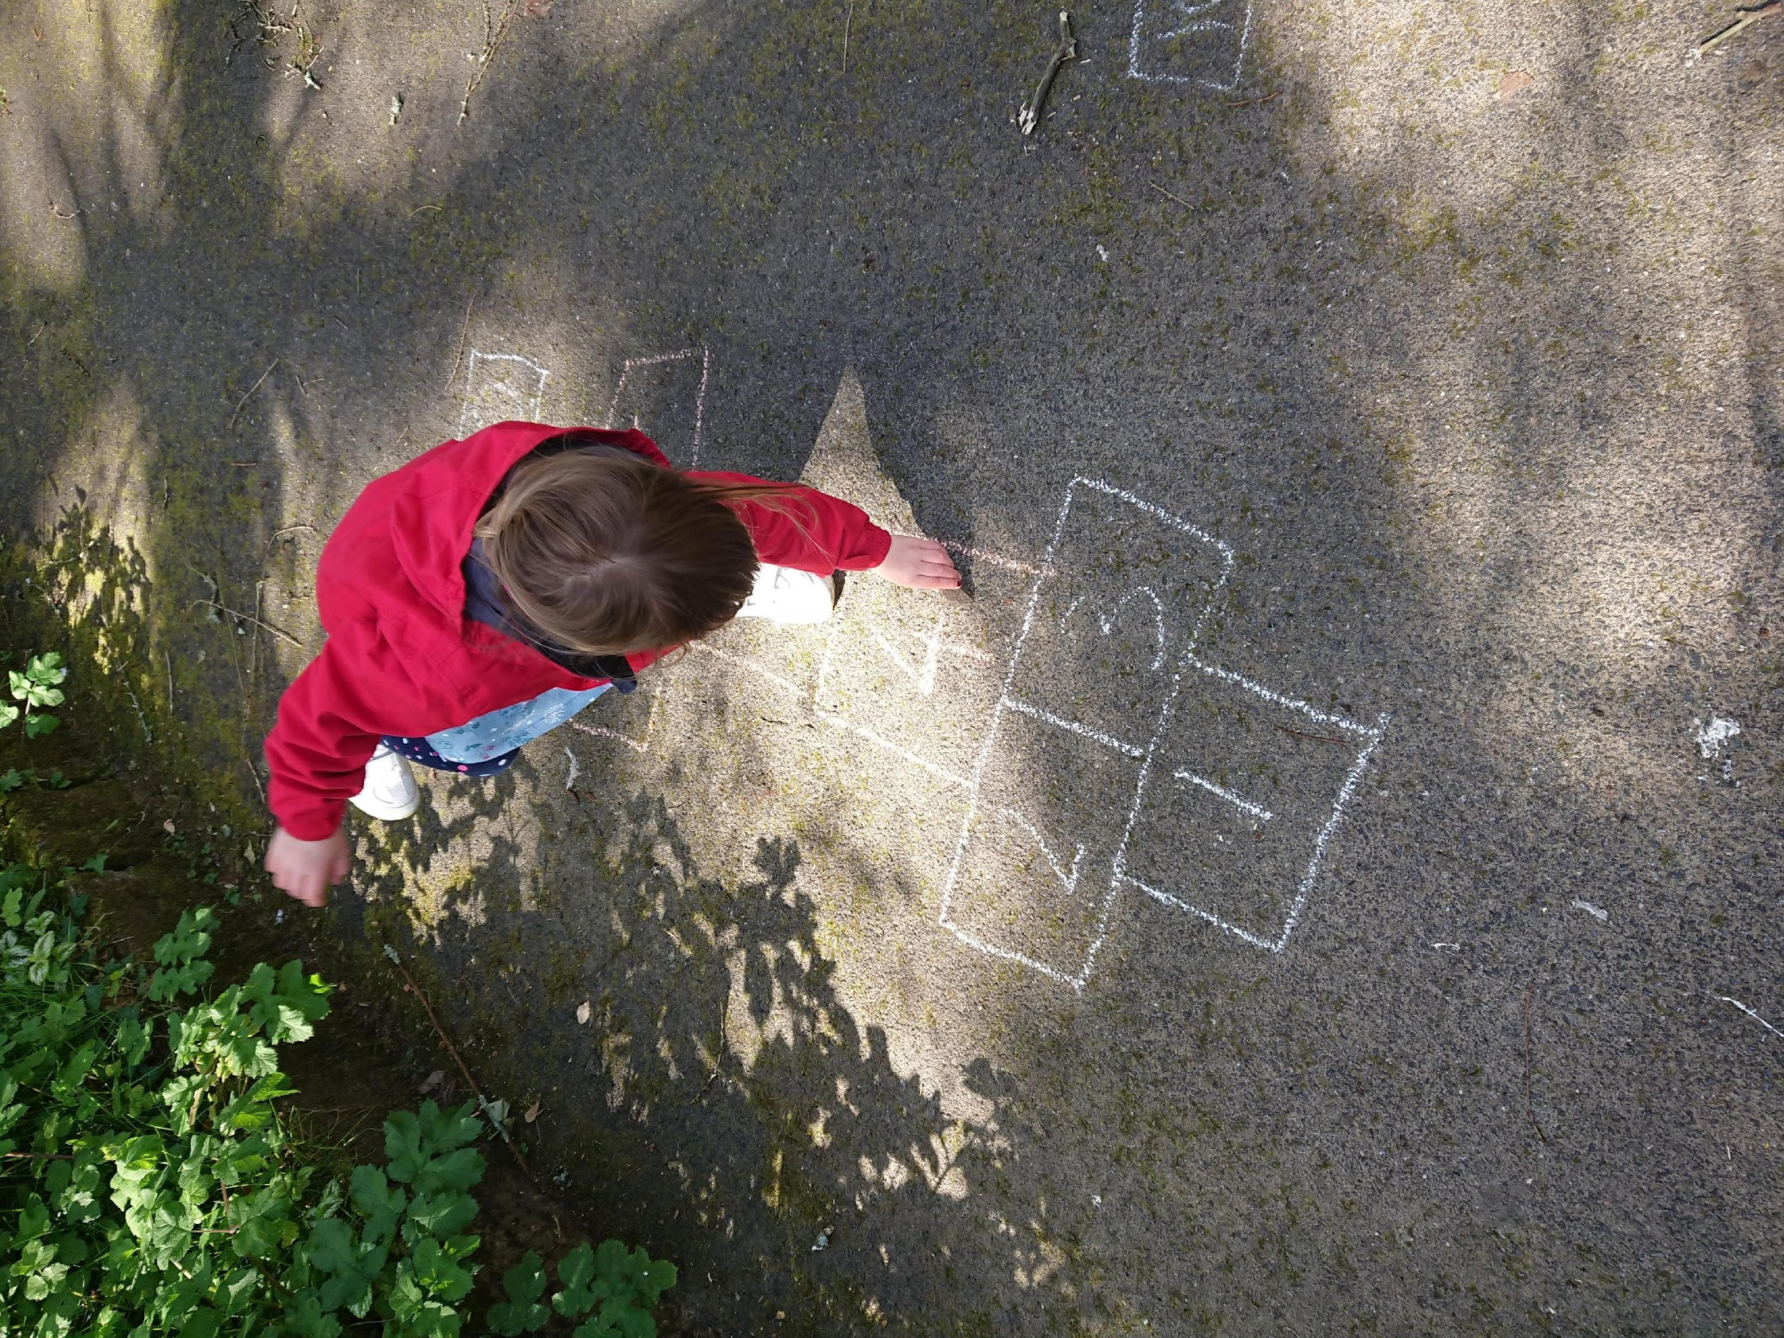
Supporting outdoor learning:
French and PE in one:
• Play ‘La Marelle’ (French hopscotch)
while counting in French, balance
on one leg while reaching for a stone, aiming at different numbers

Slide 11
Online resources to support EAL learning:
Dictionaries:
• English-Portuguese
https://www.reverso.net/translationresults.aspx?lang=EN&direction=english-portuguese
• English-Polish
https://www.reverso.net/translationresults.aspx?lang=EN&direction=english-polish
• English-Romanian https://ro.oxforddictionaries.com/
• Hindi-English https://hi.oxforddictionaries.com/
• Urdu-English https://ur.oxforddictionaries.com/
Free stories in various languages:
• https://worldstories.org.uk/

Slide 12
Online resources to support learning:
Encyclopedias written for children:
• https://wiki.kidzsearch.com/
• https://www.safesearchkids.com
• Simple Wikipedia - written with a use of simple English words and grammar- https://simple.wikipedia.org/wiki/Main_Page
Encyclopedias in other languages:
• Portuguese - https://pt.wikipedia.org/wiki/Wikip%C3%A9dia_em_portugu%C3%AAs
• Polish - https://pl.wikipedia.org/wiki/Wikipedia
• Romanian - https://ro.wikipedia.org/wiki/Pagina_principal%C4%83

Slide 13
Additional supporting resources can be found on our website under the section:
Our Learning - English as an Additional Language
thank you, obrigada
dziękuję, mulţumesc
merci, gracias
ขอบคุณ, teşekkürler
mèrcie bien des fais
cпасибо, salamat
धन्यवाद, kitos
köszönöm, ধন্যবাদ
wazviita, asante

